Slide 1
Lexical flexibility in English: A preliminary study
10/16/2019
Daniel W. Hieber
University of California, Santa Barbara
danielhieber.com
College of William & Mary, Department of Linguistics, Williamsburg, VA

Slide 2
What part of speech is friend?
Noun
Verb
Adjective
Notes:
[Take a poll]

Slide 3
friend as Noun
I got a spooky box from my best friends.
Secrets don't make friends, Luke.
Just think I saw an old college friend on TV meeting Hilary Clinton.
Notes:
Twitter data from W&M students

Slide 4
friend as Verb
What's your user? I would love to friend you and look at it when finished!
If we don't have mutual friends we can't get friended.
I accidentally downloaded Facebook and created a profile and friended a bunch of people.

Slide 5
friend as Adjective
the guy became the national symbol of friend zone in just a day
Facebook just put me in the damn friend zone with my wife
can someone help me with some friend drama?

Slide 6
What does the dictionary say?
Dictionary.com: verb, noun
Merriam-Webster: verb, noun
Why not adjectives?

Slide 7
Nouns Modifying Nouns
Are they compounds?
health care vs. healthcare
friend zone vs. friendzone
Notes:
Tempted to analyze nouns modifying nouns as compounds. Does this work?

Slide 8
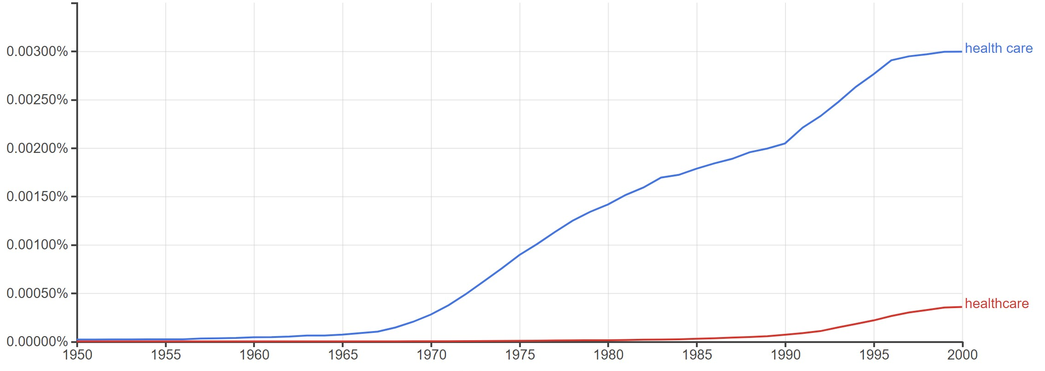
health care vs. healthcare (Google Books)
Notes:
In some cases, nouns modifying nouns do become compounds.
But not in every case.

Slide 9
Nouns Modifying Nouns
Are they compounds?
health care vs. health care
friend zone vs. friendzone
We don’t analyze these as adjectives because:
tradition
the change is unmarked
Notes:
friendzone doesn’t (yet) appear in the Google Books corpus
Linguists selective about their criteria
Cherry pick to accommodate:
tradition
their theoretical perspective

Slide 10
Aside
the truth is they friendzone everyone who tries to be with them
just ate two slices of veggie pizza for lunch so basically I'm all healthed up for at least a month
Notes:
friendzone – does appear on Twitter; entire phrase can become lexicalized (a new meaningful word in itself)
healthed – very unexpected use of this word as a verb

